Slide 1
Design patterns
Dr. Zhijun Wang

Slide 2

Dependency
In our UML example above the dependency means that class A uses class B, but that class A does not contain an instance of class B as part of its own state. It also means that if class B’s interface changes it will likely impact class A and require it to change. I suggest that you constrain your use of dependency relationships to non-state related concerns. You would use dependency to indicate that, for example, class A receives an instance of class B as a parameter to at least one of its methods. You would also use dependency to indicate that class A creates an instance of class B local to one of its methods (on the stack). You would not, however, use dependency to indicate that class A declares an instance variable of class B, as that would indicate a state-related concern. Again, use association to do that (covered next).

Slide 3
Dependency
In Java, the following is the proper interpretation of the constrained dependency relationship:
import B;
public class A {
public void method1(B b) { // . . . }
public void method2() { B tempB = new B()}
}
Actually either one of class B’s uses, as a parameter to a method, or as a local instance reference inside a method, would be appropriate reflection of a UML dependency relationship. Basically to Java the constrained dependency relationship means that you must import class B into class A so that class A may reference it in some way in a method.

Slide 4
Dependency
However, the following would be an incorrect implementation of the constrained dependency relationship in Java:
import B;
public class A {
private B b; // wrong!
public B getB() { 11/12/2017 Understanding UML Class Relationships https://vaughnvernon.co/?page_id=31 4/10
return b; }
}
In the above example class B is used to define the state of an instance of class A by declaring an instance of class B with the instance scope. However, this is a misinterpretation of the dependency relationship. But that does lead us to the use of the next UML class relationship type, association.

Slide 5

Association
it means that class A1 is associated with class B1. In other words, class A1 uses and contains one instance of class B1, but B1 does not know about or contain any instances of class A1.
class Asset-B { ... }
class Player-A {
Asset-B asset;
Public:
Player-A(Asset-B purchasedAsset) { ... } /*Set the asset via Constructor or a setter*/
}
So, in a sense the association relationship specifies what the constrained dependency relationship does not. The association relationship does define the state of instances of the dependent class. The dependent class (A1) must, therefore, define an instance of the associated class (B1) within its class scope.

Slide 6
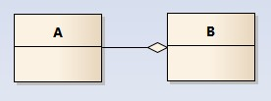
Aggregation
Class B{
public:
B(A existObj){ element = existObj;}
private:
A& element; or
A * element; or
vector<A& or A* or A> vElement;
}
Class A existObj is already exist, and passed to B, more important maybe is to use list or vector when compares with association.
Attention: now source is B point to target to A, you can image there is an arrow at the end of A side, means B uses A.

Slide 7
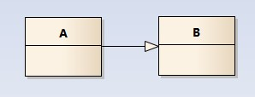
Generalization
泛化关系用一条带空心箭头的直接表示；如图表示（A继承自B）

Slide 8
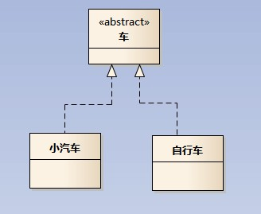
Realize
实现关系用一条带空心箭头的虚线表示,”车”为一个抽象概念，在现实中并无法直接用来定义对象；只有指明具体的子类(汽车还是自行车)，才 可以用来定义对象（”车”这个类在C++中用抽象类表示，在JAVA中有接口这个概念，更容易理解.
注：最终代码中，实现关系表现为继承抽象类；

Slide 9
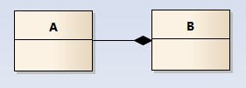
Composition
Class B{
public:
B(){ }
private:
A element;
}
Class A object element is one instance of the state of B and must be created inside the class B. This is the difference between association.
Attention: now source is B point to target to A, you can image there is an arrow at the end of A side, means B uses A.

Slide 10
Creational Patterns
2.1Builder
2.2Factory
2.2.1Abstract Factory
2.3Prototype
2.4Singleton

Slide 11
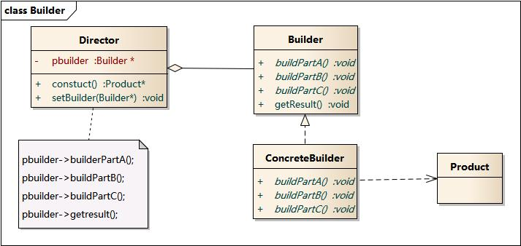
Builder

Slide 12
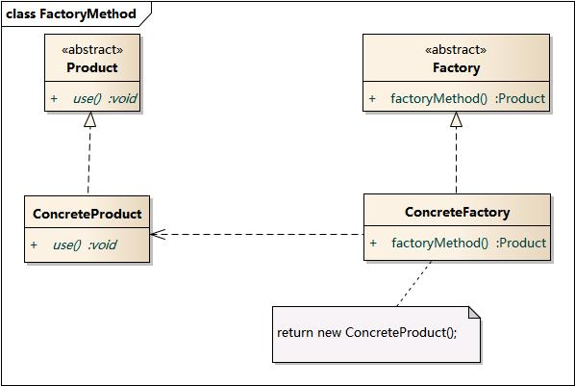
Factory

Slide 13
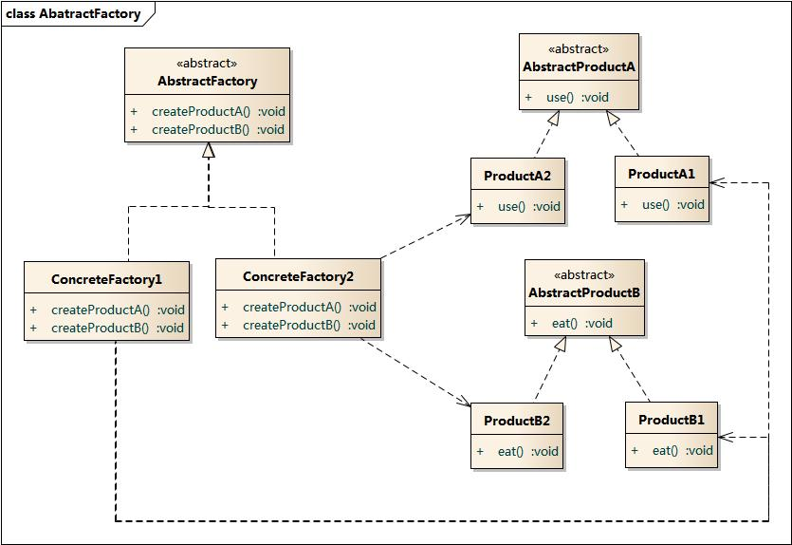
Abstract Factory

Slide 14
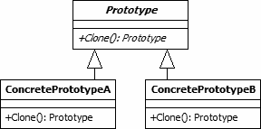
1.3 Prototype

Slide 15
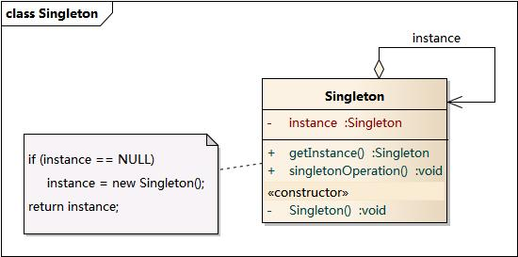
1.4 Singleton

Slide 16
Structural Patterns
3.11. Adapter
3.22. Bridge
3.33. Composite
3.3.14. Decorator
3.45. Facade
3.56. Flyweight
3.67. Proxy
3.7Curiously Recurring Template
3.8Interface-based Programming (IBP)

Slide 17
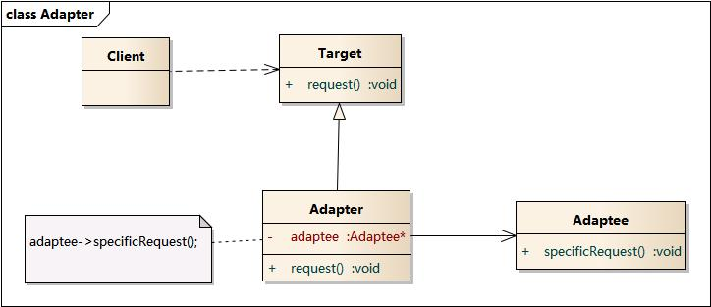

Slide 18
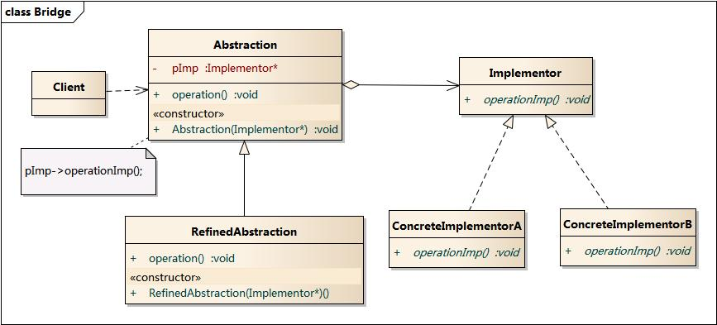

Slide 19
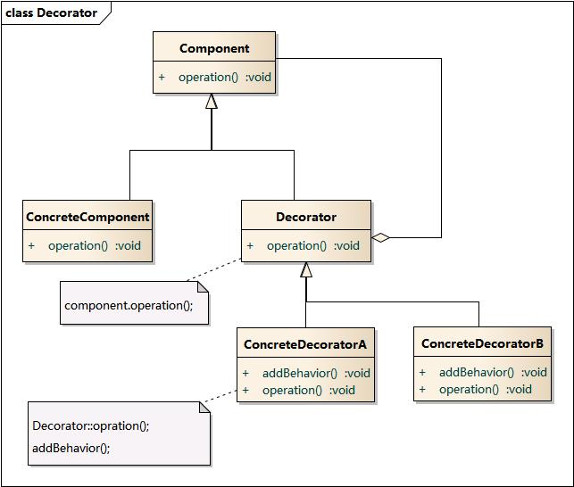

Slide 20
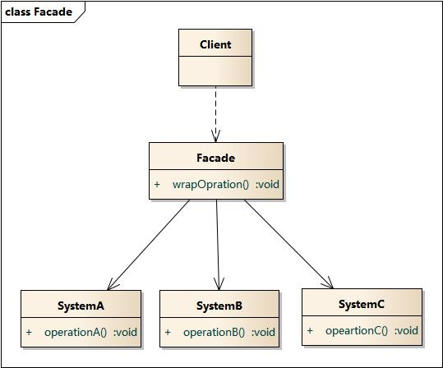

Slide 21
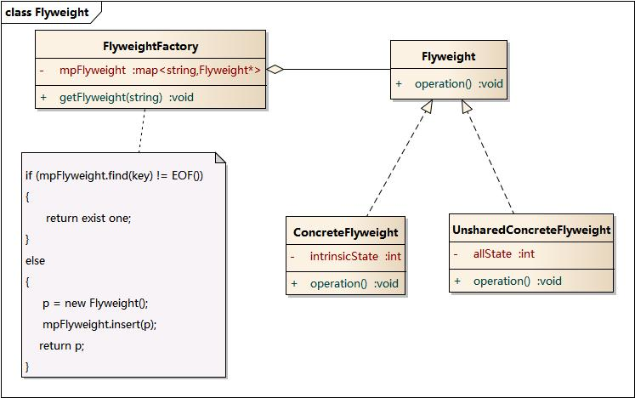

Slide 22
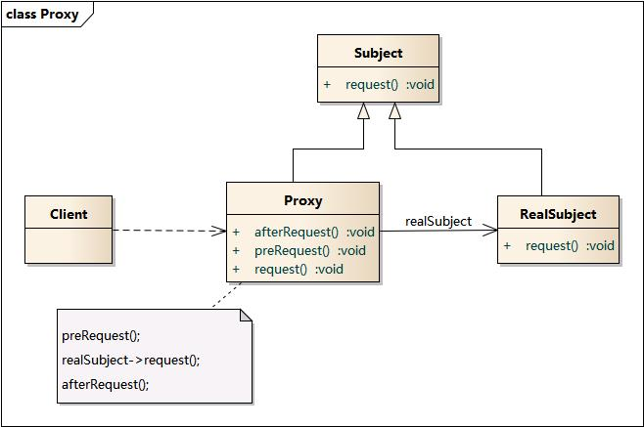

Slide 23
Behavioral Patterns
4.1Chain of Responsibility
4.2Command
4.3Interpreter
4.4Iterator
4.5Mediator
4.6Memento
4.7Observer
4.8State
4.9Strategy
4.10Template Method
4.11Visitor
4.12Model-View-Controller (MVC)

Slide 24
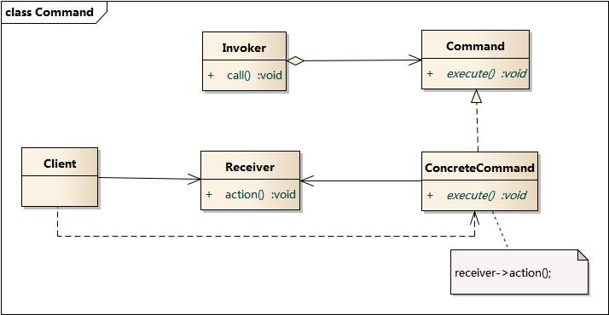

Slide 25
Command

Slide 26
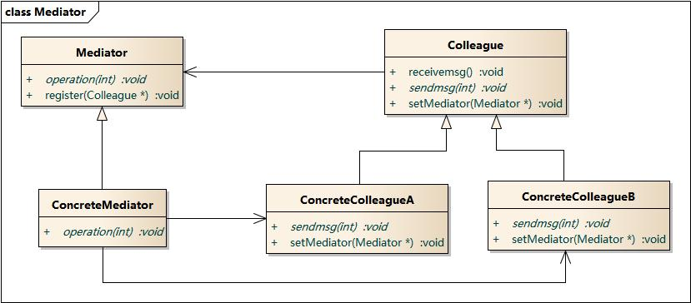

Slide 27
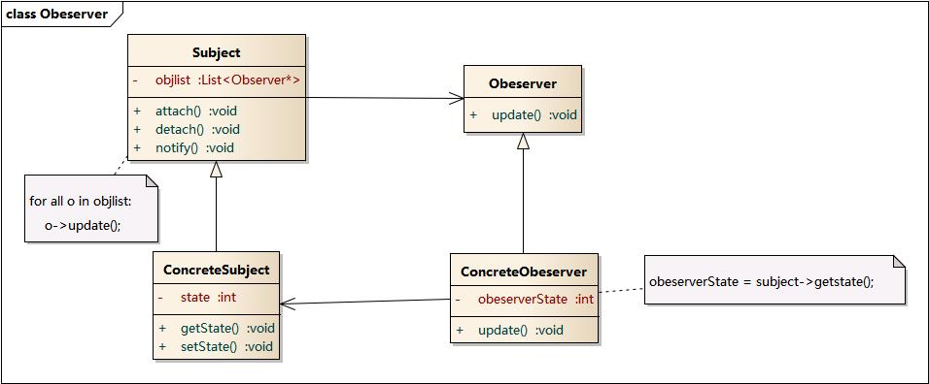

Slide 28
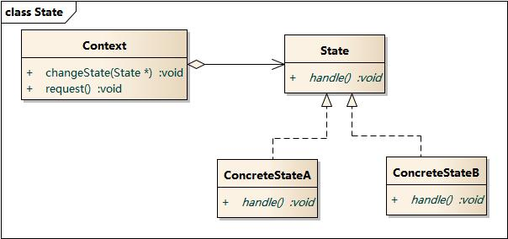

Slide 29
